Slide 1
Numerical examples

Slide 2
A drawer contains:
4 red socks
6 brown socks
8 green socks
A man is getting dressed one morning and barely awake when he randomly selects 2 socks from the drawer (without replacement, of course). What is the probability that both of the socks he selects are green given that they are the same color?

Slide 3
Medical records reveal that of the 937 men who died in a particular region in 1999:
212 of the men died of causes related to heart disease,
312 of the men had at least one parent with heart disease
Of the 312 men with at least one parent with heart disease, 102 died of causes related to heart disease. Using this information, if we randomly select a man from the region, what is the probability that he dies of causes related to heart disease given that neither of his parents had heart disease?
Also what is the probability that he dies of causes related to heart disease given that at least one of his parents had heart disease?

Slide 4
Let X equal the IQ of a randomly selected American. Assume X ~ N(100, 16²).
What is the probability that a randomly selected American has an IQ below 90?
Also what is the probability that a randomly selected American has an IQ above 140?

Slide 5
Suppose X, the grade on a midterm exam, is normally distributed with mean 70 and standard deviation 10. The instructor wants to give 15% of the class an A (the highest grade).
What cutoff should the instructor use to determine who gets an A?
The instructor now wants to give 10% of the class an A− (the second highest grade). What cutoff should the instructor use to determine who gets an A−?
The instructor fails a student if the score is less than 40. What is the probability that a student will fail the exam?

Slide 6
Suppose, from a Normal distribution(μ=20, σ=5), we draw a sample of size n=16 and want to know how likely we are to see a sample average greater than 22?
Suppose we were to select a sample of size 49 in the example above instead of n=16. How will this affect the standard error of the mean? How do you think this will affect the probability that the sample mean will be >22?

Slide 7
Boys of a certain age are known to have a mean weight of μ = 85 pounds. A complaint is made that the boys living in a municipal children's home are underfed. As one bit of evidence, n = 25 boys (of the same age) are weighed and found to have a mean weight of ¯x¯ = 80.94 pounds with a standard deviation of 10 pounds. Based on the available data, what should be concluded concerning the complaint?

Slide 8
In a packing plant, a machine packs cartons with jars. It is supposed that a new machine will pack faster on the average than the machine currently used. To test that hypothesis, the times it takes each machine to pack ten cartons are recorded. The results in seconds, are shown in the following table.
New machine |  |  |  |  | Old machine
42.1 | 41.3 | 42.4 | 43.2 | 41.8 | 42.7 | 43.8 | 42.5 | 43.1 | 44.0
41.0 | 41.8 | 42.8 | 42.3 | 42.7 | 43.6 | 43.3 | 43.5 | 41.7 | 44.1
¯x1¯ = 42.14, s₁ = 0.683 |  |  |  |  | ¯x2¯= 43.23, s₂ = 0.750
Do the data provide sufficient evidence to conclude that, on the average, the new machine packs faster? Perform the required hypothesis test at the 5% level of significance.

Slide 9
An engineer measured the Brinell hardness of 25 pieces of ductile iron that were subcritically annealed. The resulting data were:
170 | 167 | 174 | 179 | 179 | 187 | 179 | 183 | 179
156 | 163 | 156 | 187 | 156 | 167 | 156 | 174 | 170
183 | 179 | 174 | 179 | 170 | 159 | 187
The engineer hypothesized that the mean Brinell hardness of all such ductile iron pieces is greater than 170. What would be the conclusion of the hypothesis test?

Slide 10
Your company wants to improve sales. Past sales data indicate that the average sale was $100 per transaction. After training your sales force, recent sales data (taken from a sample of 25 salesmen) indicates an average sale of $130, with a standard deviation of $15. Did the training work? Test your hypothesis at a 5% alpha level.

Slide 11
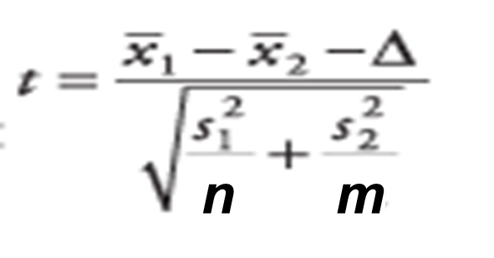
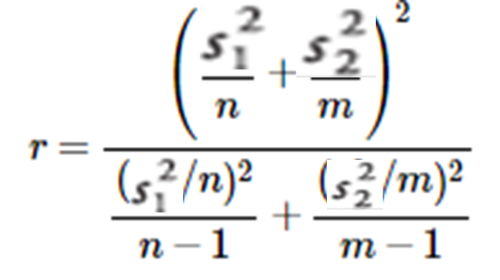
Variable | N | Mean | StDev
sophomor | 17 | 2.840 | 0.520
juniors | 13 | 2.9808 | 0.3093
Test
H0:μ1−μ2=0 Ha:μ1−μ2≠0
For α=0.05
(Assume the sampling distribution to be normal, population variances are unequal

Slide 12
Lung destructive index We wish to know if we may conclude, at the 95% confidence level, that smokers, in general, have greater lung damage than do non-smokers. Data Smokers: = 17.5 = 16 = 4.4752 Non-Smokers: = 12.4 = 9 = 4.8492 = .05

Slide 13
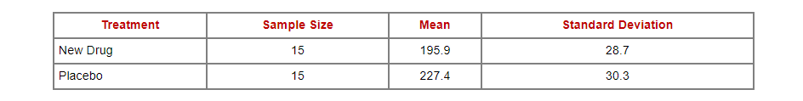
A new drug is proposed to lower total cholesterol. A randomized controlled trial is designed to evaluate the efficacy of the medication in lowering cholesterol. Thirty participants are enrolled in the trial and are randomly assigned to receive either the new drug or a placebo. The participants do not know which treatment they are assigned. Each participant is asked to take the assigned treatment for 6 weeks. At the end of 6 weeks, each patient's total cholesterol level is measured and the sample statistics are as follows.
Is there statistical evidence of a reduction in mean total cholesterol in patients taking the new drug for 6 weeks as compared to participants taking placebo? (Assume the sampling distribution to be normal, population variances are equal and significance level to be 5%.

